Slide 1
Indian Airline Fare Prediction

Slide 2
Project Description
Indian Airline Fare Prediction is Internship Project is an Data Science project comprising of multiple tasks. The project is based on Real time streaming data on Indian Airline data
And create provides insights on Aviation Industry of India.
Focus: Use real-time streaming data on Indian airlines to develop a predictive model.
Scope: The scope of project is divided in following steps and these are meant to be followed sequentially
1. The Data is stored in real time using Data ETL pipelines and canbe accessed from snowflake .
2. The Data is preprocessed and used in Machine learning .
3. Furthermore an LLM is used to query data and write responses to interact with users in natural language.
4. Lastly a dashboard Is created to visualize hidden trends and patterns in data.

Slide 3
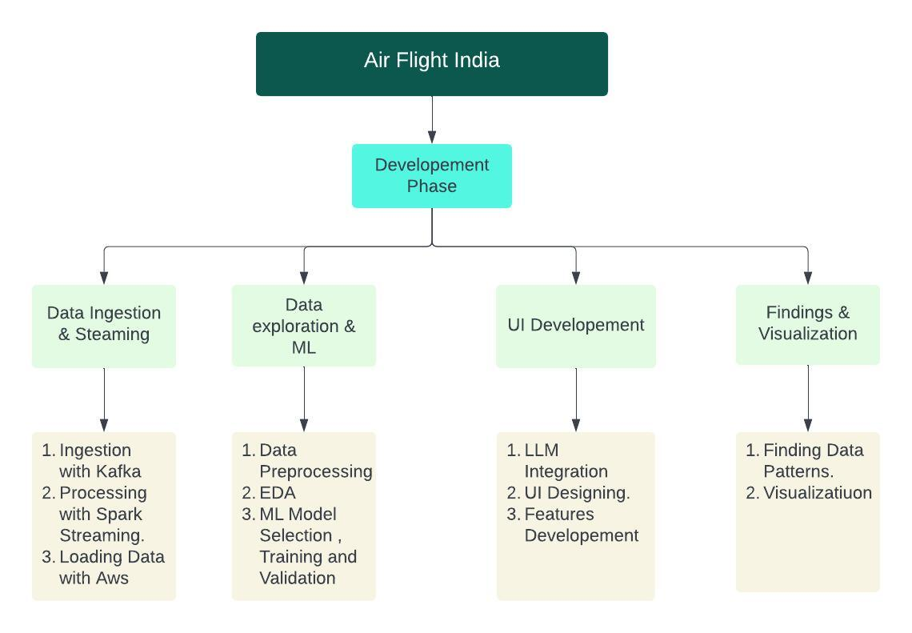
Work Breakdown Structure
Additional text to accompany the content on the left
Task 1: Data Pipeline Setup (Weeks 1-2)
Ingestion: CSV to Kafka
Processing: Spark to S3
Loading: AWS Glue to Snowflake
Automation: Scripts for ingestion and processing
Task 2: Data Exploration & ML (Weeks 3-4)
Exploration: Preprocess and analyze data
Modeling: Train, validate, evaluate ML models
Documentation: Record model performance details
Task 3: UI Development (Weeks 5-6)
Interface: Natural language querying
Visualization: Tools for data insights
Deployment: Model on EC2
Task 4: Findings & Visualization (Week 6)
Summary: Key insights and patterns
Dashboards: Interactive visualizations

Slide 4

Management Approach
Project Management:
Role: Mentor oversees project milestones and ensures timely completion of tasks.
Data Management:
Ingestion: Scripted ingestion of data from CSV to Kafka topics.
ML Management:
Model Comparison: Evaluate multiple models based on performance metrics, training time, and size.
Documentation: Detailed records of model performance and selection criteria.
UI Management:
Framework: Flask for developing the querying and visualization interface.
Deployment: Hosting the interface on an EC2 instance for accessibility.

Slide 5













Requirements
Common Requirements
Data ETL
Machine learning​
AWS
Snowflake
kafka
Pyspark
Python
Google Colab
Machine Learning​
Mobile
Data Visualisation
Streamlit
LLM
Power Bi Desktop

Slide 6
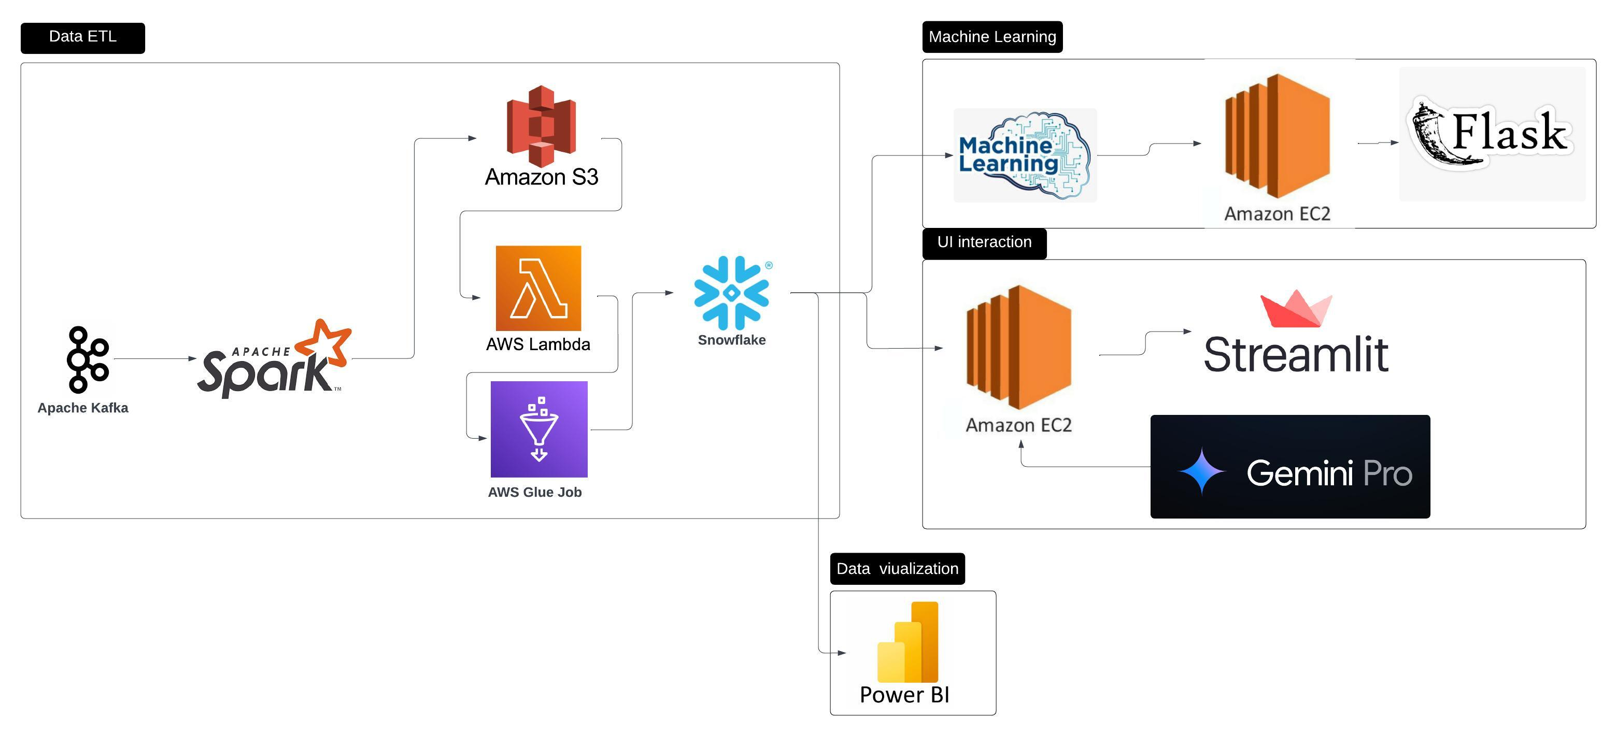
Project Design

Slide 7
Project Description
Task 1 Data Ingestion and ETL - Kafka is used to stream our data and this data is written in S3 with spark, The next part of ETL is entirely on Cloud .It follows ETL and stores data in snowflake .
Task 2 Machine Learning - we use Snowflake as input and and preprocess the data. Different models are compared and evaluated . The final model selected is XGBoost . XGBoost performs with R2 score of 0.91 and althought it lags behind Random Forest Regressor .Its small size make it excellent for working with small microprocessors and scale up easily.
Our all preprocessing and machine learning models are used in flask application to make a web app that can predict Flight Fare based on User Input.
Task 3 UI Interaction- we use Gemini Pro api whose task is to convert text to sql . We perform prompt engineering to diirect our model to make right queries. And we pass this query on snowflake. Finally we create a streamlit application doing all mentioned and deploy it on EC2.
Task 4 Data Visualization -, We perform Visualisation with Power BI Desktop.We make dashboard illustrating information about data and show trends unseen before.

Slide 8
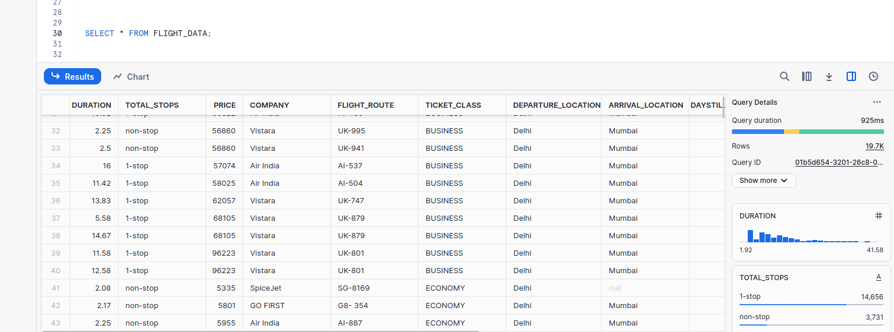
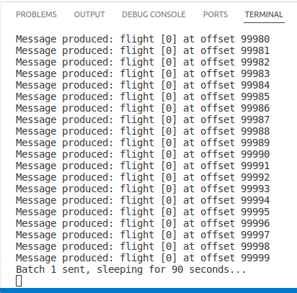
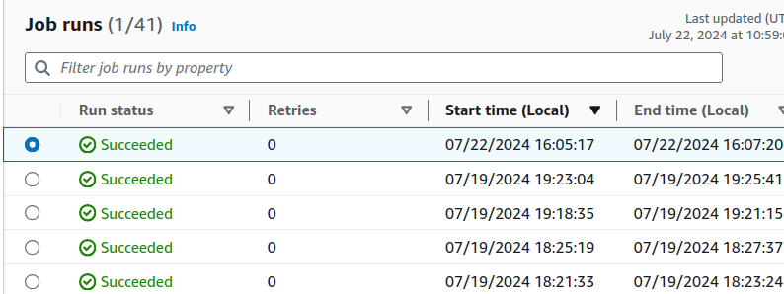
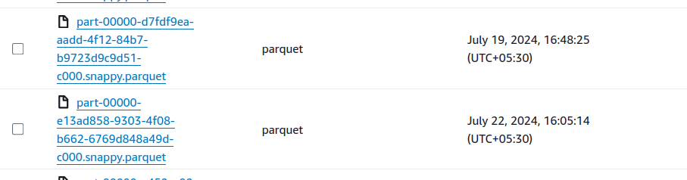
Result
Data ETL

Slide 9
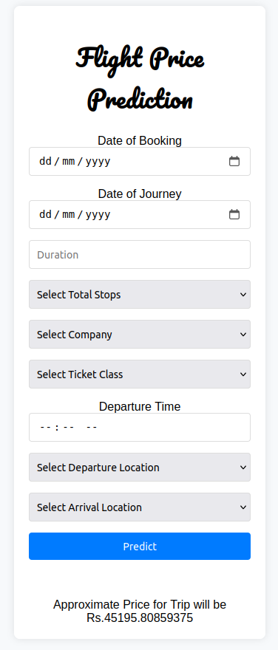
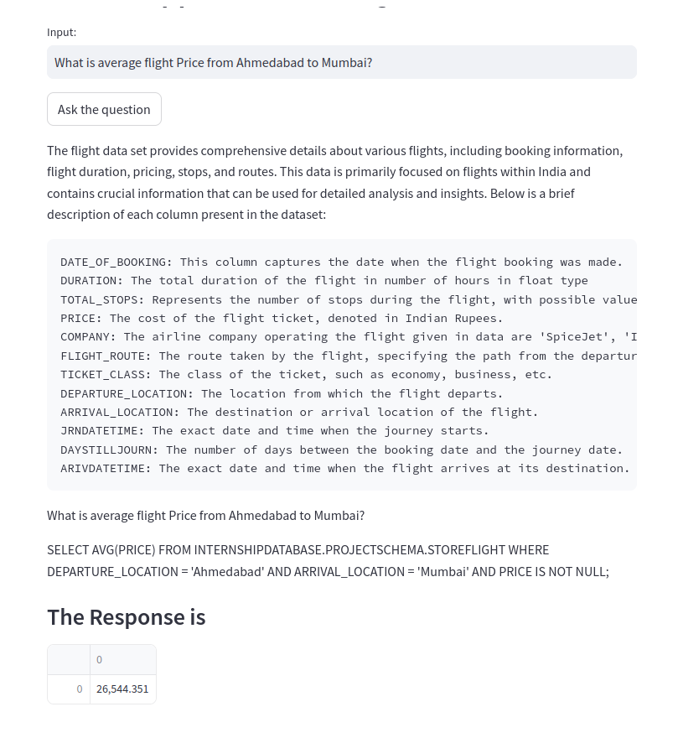
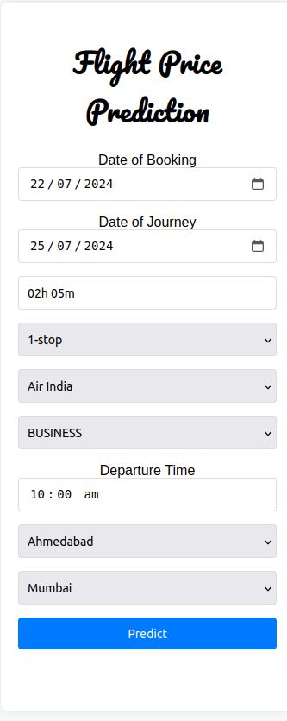
Result
ML and UI

Slide 10
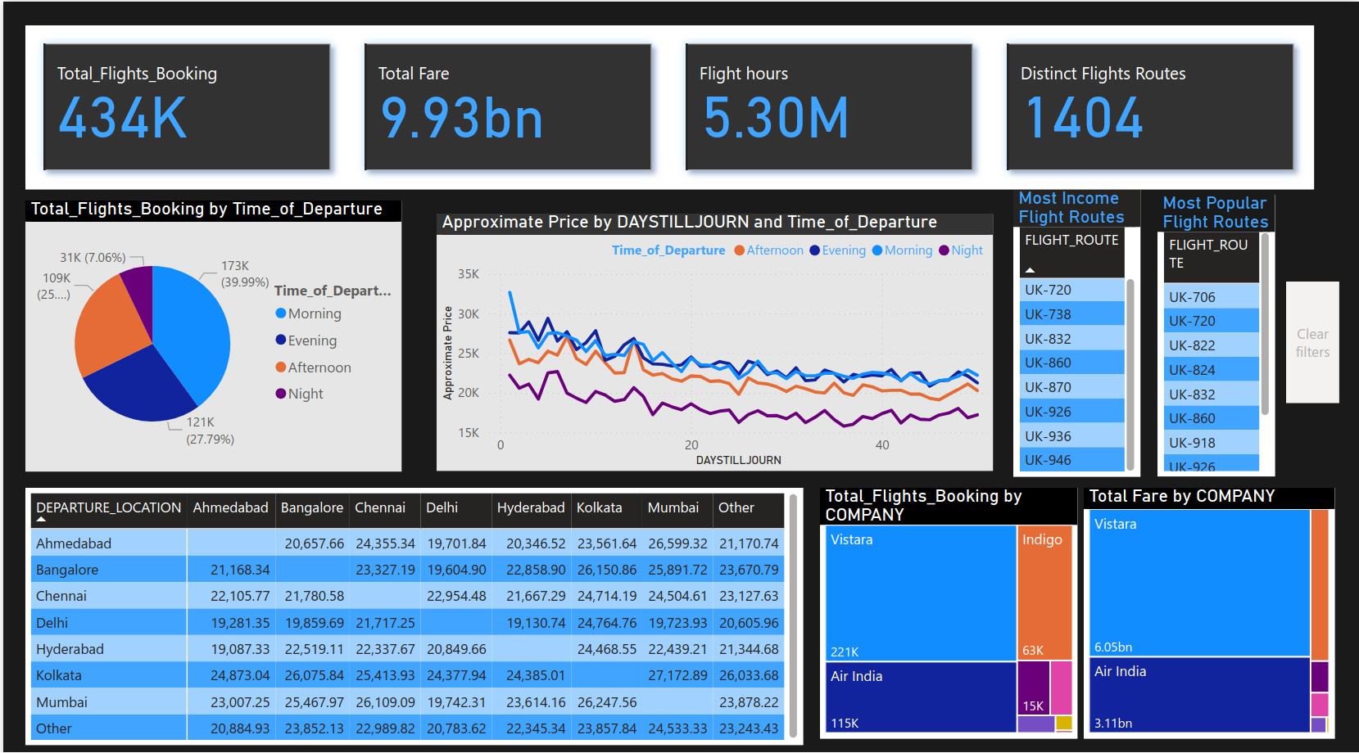
Result
Data viusalization

Slide 11






Icon List Slide
We make partners rather than clients and when partners grow, we also grow, simple!
Agile
History & Track Record​
Expertise​
Our agile principles mean that we’re quick to react and able to adapt plans, processes or strategies accordingly.
Since 2011, we’ve helped our clients build a wide range of award-winning digital products including mobile apps, web platforms and more. Continuous improvement has meant we’ve applied all of our learnings to future projects. ​
Great people build great products. We house an incredibly talented team of innovation strategists, product managers, developers, growth hackers UX/UI designers and much more.
Collaborative​
Entrepreneurial Culture​
Value Creation​
Our collaborative-led approach has been a key factor in our success. Through closely working together, we better understand each other and ultimately, the end vision for the project.​
Despite our size, we still act like start-up in many ways. We encourage and foster our employees’ entrepreneurial spirt and in doing so, we treat every project as if it’s our own company.​
We are not just value-driven, but we’re value-creating. We look at areas where we can deliver value across the whole product lifecycle in an eﬃcient way that it will generate proﬁt.

Slide 12

Contact us
Vikas Agarwal
Founder | Product Evangelist
+91 99255 66622
vikas@growexx.com

